Slide 1
Introduction to Coroutines
What is a Coroutine?
A coroutine is a as a light-weight thread.
Like threads, coroutines can run in parallel, wait for each other and communicate.
The biggest difference is that coroutines are very cheap, almost free: we can create thousands of them, and pay very little in terms of performance.
What are Coroutines for?
Async work
Multi-threading
What concepts do Coroutines bring?
Suspend function
Coroutine Builders
Coroutine scopes and dispatchers
How do you handle async work with Coroutines?
Mark async methods as suspended and create a coroutine to listen for the results

Slide 2
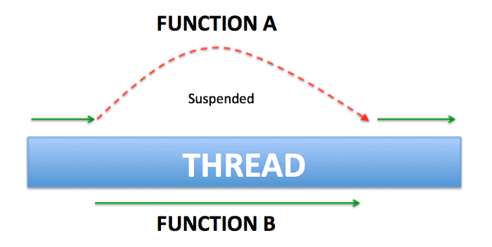
Basic concepts of Coroutines
Suspend functions
The method associated with this modifier is asynchronous and will not be returned immediately.
How do you mark a method as suspendable?
suspend fun mySuspendedFunction(): String
One can call suspended functions from other suspended functions or inside a coroutine.

Slide 3
Basic concepts of Coroutines
Coroutine builders
Coroutine builders are simple functions that can create a coroutine and act as a bridge between the normal world and the suspending world. They are called on scopes.
Types:
launch – launches coroutine and forgets
async – returns a deferred object
runBlocking – runs on Main thread
private fun fetchItemDetails(id:Int) { scope.launch() {
val resultString = mySuspendedFunction ()
}
// Other calls are executed immediately }

Slide 4
Basic concepts of Coroutines
Coroutine scope and dispatchers
The scope object of a Coroutine dictates how long the coroutine should live and wait for results.
Predefined scopes:
GlobalScope
lifecycleScope
rememberCoroutineScope
viewModelScope
private fun fetchItemDetails(id:Int) { scope.launch() {
val resultString = mySuspendedFunction ()
}
// Other calls are executed immediately }
How is a custom scope defined?
By passing a job and a Dispatcher

Slide 5
Basic concepts of Coroutines
Coroutine scopes and dispatchers
What is a job?
A job can be used as a handle to coroutine where we can track the wait time and cancel it.
private val job = Job() val scope = CoroutineScope(job + Dispatchers.IO) private fun fetchItemDetails(id:Int) { scope.launch() {
val resultString = mySuspendedFunction ()
}
// Other calls are executed immediately } override fun onDestroy() { super.onDestroy() job.cancel() }
What is a Dispatcher?
It is used to specify which thread a coroutine uses for its execution. One can specify the dispatcher to the builder.
Dispatcher types:
Main – UI
Default - CPU
IO – networking or file access

